Slide 1
Business Intelligence Concepts, Tools, and Applications
Week 2: Business Intelligence Concepts and Platform Capabilities
Lesson 3: Business Reporting

Slide 2
Business Reporting
Learning Objectives
List multiple types of business reports and describe their shared building blocks
Summarize different questions business reports grapple with and the options for displaying the answers.
Learn the components and structure of the business reporting systems
Create various reports using MicroStrategy BI platform

Slide 3
Business Report
Report?
Any communication artifact prepared to convey specific information
A report can fulfill many functions
To ensure proper departmental functioning
To provide information
To provide the results of an analysis
To persuade others to act
To create an organizational memory…
Adopted from Sharda, R. Delen, D. and Turban, E. (2015), Business Intelligence and Analyti cs: Systems for Decision Support, 10 ED, Chapter 4

Slide 4
Business Report
Business report is A written document that contains information regarding business matters.
Purpose: to improve managerial decisions
Source: data from inside and outside the organization (via the use of ETL)
Format: text + tables + graphs/charts
Distribution: in-print, email, portal/intranet
Types (in terms of content and format)
Informal – a single letter or a memo
Formal – 10-100 pages; cover + summary + text
Short report – periodic, informative, investigative
Source: Sharda, R. Delen, D. and Turban, E. (2015), Business Intelligence and Analyti cs: Systems for Decision Support, 10 ED, Chapter

Slide 5
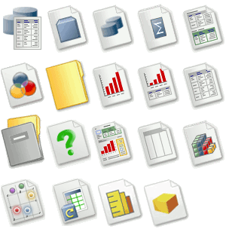
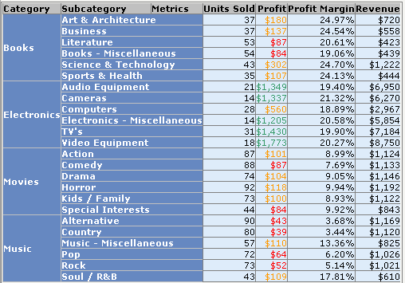
Business Reports Building Blocks
Attributes
Metrics
Descriptive information providing business context and defining summarization levels for calculations
Quantitative business measures
Notes:
Source: this slide is from MicroStrategy
While reports can be distributed in print form or via e-mail, they are typically accessed via a corporate intranet.

Slide 6
Business Reports Building Blocks
Report Grid or Table
Basic building block for every business analytic application
Notes:
Source: this slide is from MicroStrategy
Before we go into BI specifics, clarify some of the terminology of words you will use throughout the presentation. Terms like attributes, facts and metrics are specific to MicroStrategy, so you should orient students what these words mean before you start using them. Use the next few slides to explain the terms on them.
The foundation of these reports is various sources of data coming from both inside and outside the organization.
Creation of these reports involves ETL (extract, transform, and load) procedures in coordination with a data warehouse and then using one or more reporting tools.

Slide 7
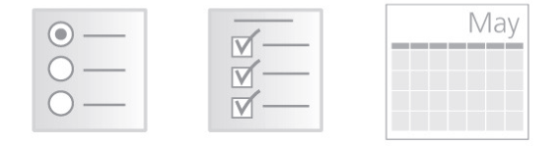

Business Reports Building Blocks
Prompts
Allow users to dynamically select the information to be displayed in the report
Filters
Purchased
in the last
6 months
My Store Items
Specify conditions the data must meet to be included on the report
Notes:
Source: this slide is from MicroStrategy

Slide 8
Types of Business Reports
Standard reports
Answer the questions: What happened? When did it happen? Example: Monthly or quarterly financial reports. We all know about these.
Ad hoc Reports
Answer the questions: How many? How often? Where? Example: Custom reports that describe the number of hospital patients for every diagnosis code for each day of the week.
Query drilldown (or OLAP)
Answers the questions: Where exactly is the problem? How do I find the answers? Example: Sort and explore data about different types of cell phone users and their calling behaviors.
From SHARDA, RAMESH; DELEN, DURSUN; TURBAN, EFRAIM, BUSINESS INTELLIGENCE AND ANALYTICS: SYSTEMS FOR DECISION SUPPORT, 10th Edition, © 2015. Used by permission of Pearson Education, Inc., New York, NY. All Rights Reserved.
Notes:
From SHARDA, RAMESH; DELEN, DURSUN; TURBAN, EFRAIM, BUSINESS INTELLIGENCE AND ANALYTICS: SYSTEMS FOR DECISION SUPPORT, 10th Edition, © 2015. Used by permission of Pearson Education, Inc., New York, NY. All Rights Reserved.

Slide 9
Types of Business Reports
Dashboard-type Reports
present a range of performance indicators on one page, with both static/predefined elements and customizable widgets and views.
Balanced Scorecard-type Reports
present an integrated view of a company’s health and include financial, customer, business process, and learning/growth perspectives.
Metric Management Reports
involve outcome-oriented metrics based on service level agreements and/or key performance indicators. Can be used as part of business performance management
From SHARDA, RAMESH; DELEN, DURSUN; TURBAN, EFRAIM, BUSINESS INTELLIGENCE AND ANALYTICS: SYSTEMS FOR DECISION SUPPORT, 10th Edition, © 2015. Used by permission of Pearson Education, Inc., New York, NY. All Rights Reserved.
Notes:
From SHARDA, RAMESH; DELEN, DURSUN; TURBAN, EFRAIM, BUSINESS INTELLIGENCE AND ANALYTICS: SYSTEMS FOR DECISION SUPPORT, 10th Edition, © 2015. Used by permission of Pearson Education, Inc., New York, NY. All Rights Reserved.

Slide 10
Business Reporting
From SHARDA, RAMESH; DELEN, DURSUN; TURBAN, EFRAIM, BUSINESS INTELLIGENCE AND ANALYTICS: SYSTEMS FOR DECISION SUPPORT, 10th Edition, © 2015. Used by permission of Pearson Education, Inc., New York, NY. All Rights Reserved.
Notes:
Source: Sharda, R. Delen, D. and Turban, E. (2015), Business Intelligence and Analytics: Systems for Decision Support, 10 ED, Chapter 4..

Slide 11
Business Reporting
Business reporting is about good story-telling.
Think of your analysis as a story—use a story structure.
Be authentic—your story will flow.
Be visual—think of yourself as a film editor.
Make it easy for your audience and you. Invite and direct discussion.
From SHARDA, RAMESH; DELEN, DURSUN; TURBAN, EFRAIM, BUSINESS INTELLIGENCE AND ANALYTICS: SYSTEMS FOR DECISION SUPPORT, 10th Edition, © 2015. Used by permission of Pearson Education, Inc., New York, NY. All Rights Reserved.
Notes:
.

Slide 12
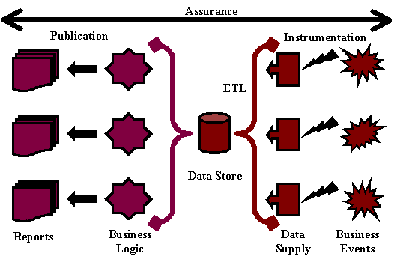
Components of Business Reporting Systems
Adopted from Hill, G. (2008). “A Guide to Enterprise Reporting.”
Notes:
Adopted from Hill, G. (2008). “A Guide to Enterprise Reporting.” http://ghill. customer.netspace.net.au/reporting/components. html (accessed February 2013).

Slide 13
Business Reporting Systems Components
According to Hill (2008) there are following components to a business reporting system:
OLTP (Online transaction processing)- A system that measures some aspect of the real world as events (e.g., transactions) and records them into enterprise databases.
Data supply- A system that takes recorded events/transactions and delivers them reliably to the reporting system.
ETL (extract, transform, and load)- This is the intermediate step where these recorded transactions/events are checked for quality, put into the appropriate format, and inserted into the desired data format.
Data storage- This is the storage area for the data and metadata. It could be a flat file or a spreadsheet, but it is usually a relational database management system (RDBMS) set up as a data mart, data warehouse, or operational data store (ODS)
Adopted from Hill, G. (2008). “A Guide to Enterprise Reporting.”
Notes:
Adopted from Hill, G. (2008). “A Guide to Enterprise Reporting.” http://ghill.customer.netspace.net.au/reporting/components.html
(accessed February 2013).

Slide 14
Business Reporting Systems Components- contd
Business logic- The explicit steps for how the recorded transactions/events are to be converted into metrics, scorecards, and dashboards.
Publication- The system that builds the various reports and hosts them (for users) or disseminates them (to users). These systems may also provide notification, annotation, collaboration, and other services.
Assurance- A good business reporting system is expected to offer a quality service to its users. This includes determining if and when the right information is to be delivered to the right people in the right way/format.
Adopted from Hill, G. (2008). “A Guide to Enterprise Reporting.”
Notes:
Source: Hill, G. (2008). “A Guide to Enterprise Reporting.” http://ghill. customer.netspace.net.au/reporting/components. html (accessed February 2013).

